Slide 1


United.com
Andrew Geden, Kevin Han,
Meet Palan, Sita Robinson, & Roy Smith
Notes:
Hello everyone, my name is Roy! Along with my group teammates Andrew, Kevin, Meet, and Sita we analyzed United.com’s website.

Slide 2
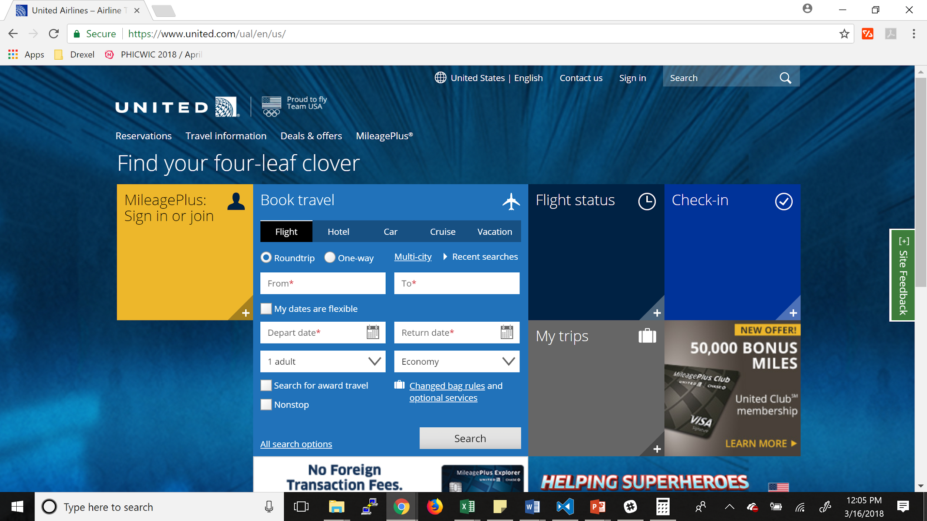
The Website
Notes:
This is the first thing that you see when navigating to United.com. I’m going to give you a brief overview of the main page of the site, which is what we decided to focus our testing on. The site is fairly basic, and there isn’t much text at the bottom as you scroll down. When you click on any of the headers or text below, the site brings you to a new page. When you click on any of the boxes in the center, the box will expand like how ‘Book Travel’ currently is. Besides that, there isn’t much else to the main page, expect that the advertisements can change each time you visit the site.

Slide 3

Demographics Setup
Gender: Any
Age : 18 - 65+ years old
Countries: Any
Income: Any
Web expertise: Any
Operating systems: Any
Web browsers: Any
Social networks: Any
Notes:
For our user testing study for United.com we set the age demographic to be 18-65+ years old. The audience includes anyone who would need or want to travel in a plane domestically or internationally. Since flight travel can include almost everyone we did not think it was necessary to specify any other factors.

Slide 4
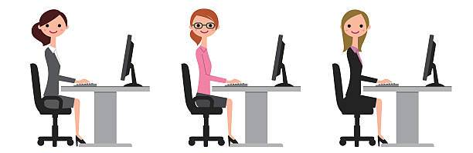

Meet the Testers
kmarielaboy
madeline_do
bag317
Similarity:
All females in their 20s from the United States
Notes:
We had three user testers for the United.com website. They are under the fake names of kmarielaboy, madeline_do, and bag317. They were all females in their 20s and from the United States.

Slide 5



Tester 1: kmarielaboy
Gender: Female
Age: 26
Income: Under $40,000
Lives in North Carolina
Notes:
The first tester was kmarielaboy. Kmarielaboy is a 26 year old female who lives in North Carolina. She has an income under $40,000.

Slide 6


Tester 2: madeline_do
Gender: Female
Age: 20
Income: Over $100,000
Lives in California
Notes:
The second tester was madeline_do. Madeline_do is a 20 year old female who lives in California. She has an income over $100,000.

Slide 7


Tester 3: bag317
Gender: Female
Age: 25
Income: $40,000-$100,000
Lives in Massachusetts
Notes:
The third tester was bag317. Bag317 is a 25 year old female who lives in Massachusetts. She has an income from $40,000-$100,000.

Slide 8
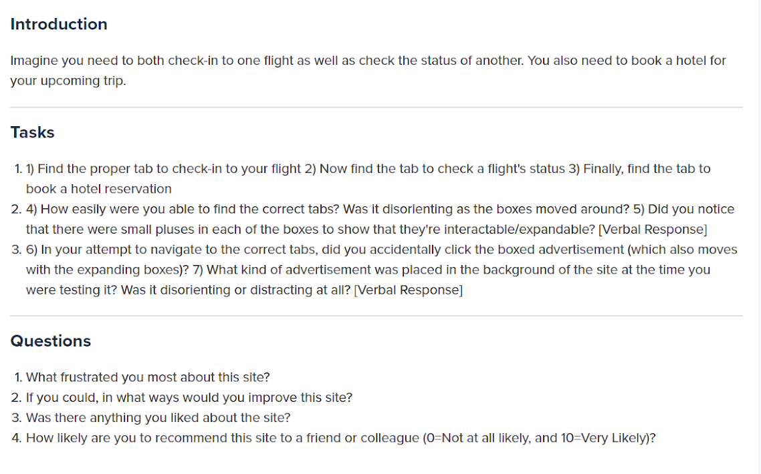
Test Plan
Notes:
This was our testing plan. We wanted it to be fairly basic, especially since we were just focusing on the main page of the site. As you can see, each task was broken up into a few sub-tasks or questions. The first task asked them to navigate around using the boxes if possible, so that we could get their feedback on specifically them. Tasks 2 & 3 were questions focused on the experience they had. The 2nd task focused on the issues we found with the moving boxes whereas the 3rd task focused on the advertisements and their placements. The questions at the end were much more open-ended, since we just wanted a general idea of how they felt about the site.

Slide 9
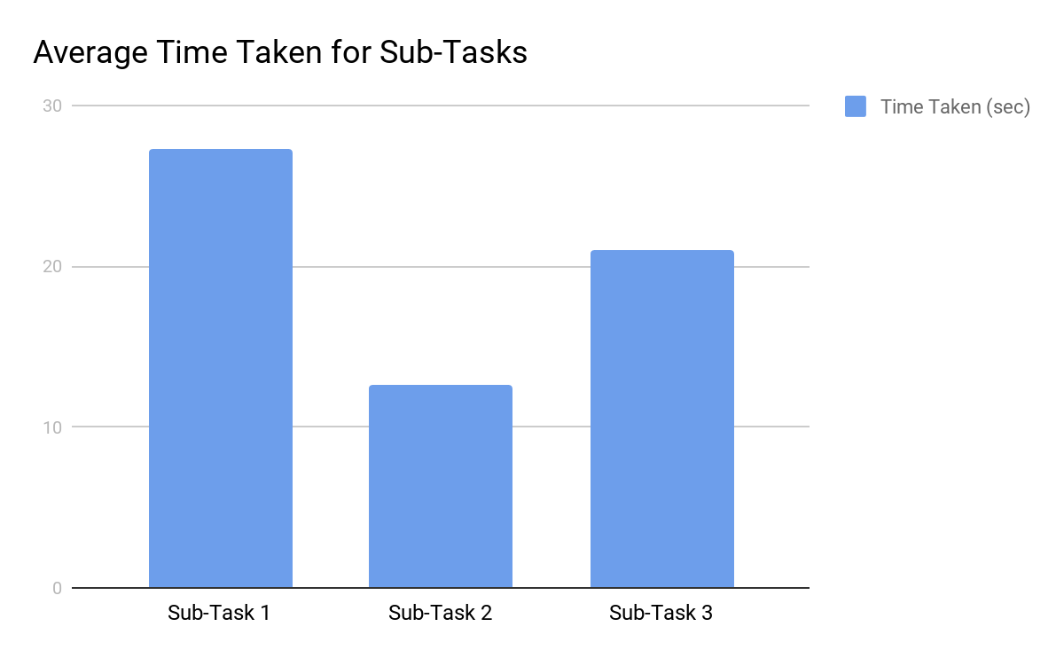
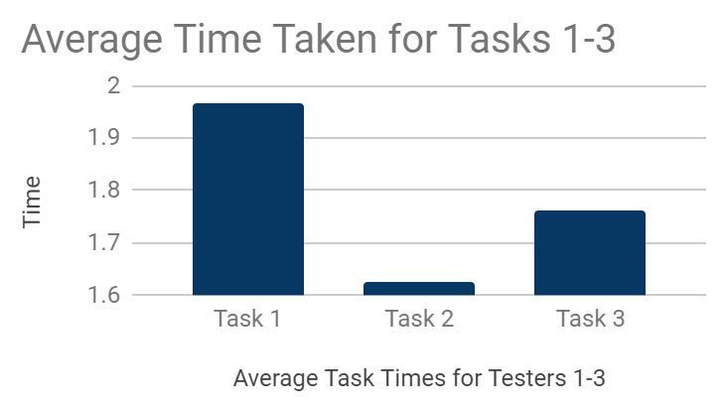
Average Time Taken for Sub-Tasks
Notes:
As you can see, the testers took longer to complete the 1st sub-task than either the 2nd or 3rd. To give you a reminder, each of these sub-tasks were just to find specific tabs on the main page. These times makes sense as the users are just getting used to the site and need to figure out how they are supposed to interact with it. The 2nd sub-task is meant to be much easier as the tab is right next to the first, making it simple for the user to go straight to the correct place. The purpose of this task was to have the user interact with and understand how the boxes would move along the site. The 3rd task took a little more time and was meant to be slightly more confusing. We wanted them to have to search a bit to show that it wasn’t obvious where certain things were. In this specific case, they need to find hotel reservations hidden under the ‘Book Travel’ tab.
What’s interesting is if we exclude the first tester, who you will see had trouble with navigating the site, we get the results we initially expected. The avg for the first task goes down to 7 seconds compared to the previous 27, the second to 9, and the third to 17. This makes sense since the first two tasks should be much simpler than the third.

Slide 10
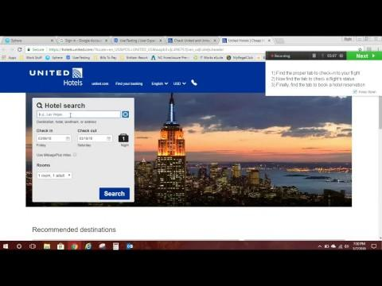
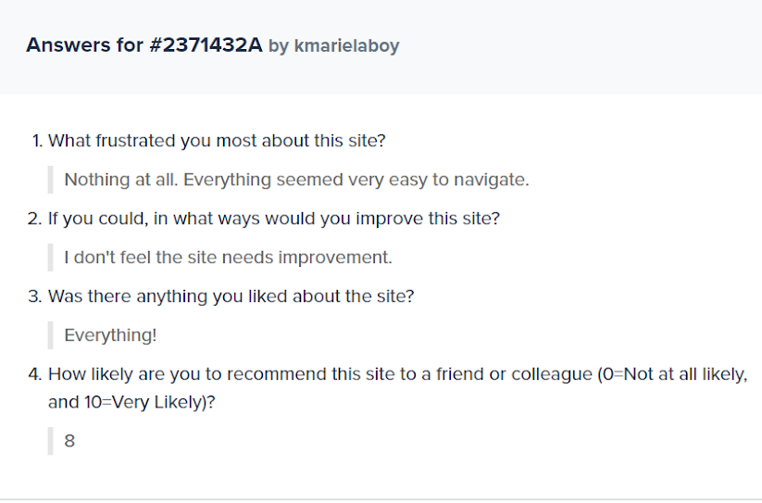
Tester 1: Ran into Navigation Issues
Highlights
Notes:
All of the testers were around the same age (20’s) and were all female. The first user took ~8 minutes as compared to 5 minutes for the other users. This tester ended up navigating to separate webpages, but for each of the tasks instead of just the one. This caused her to get stuck at some points since the tasks were written with the idea that the user was to stay at the main page and interact with the expandable boxes. This also means she had some trouble answering our post-test questions. Here you can see about two minutes of her testing compressed down to 30 seconds.

Slide 11
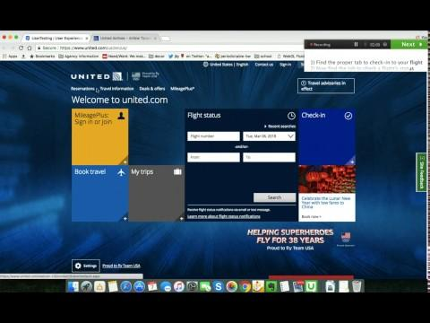
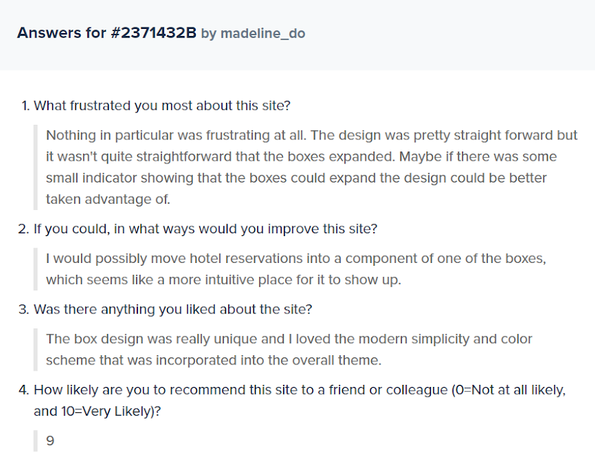
Tester 2: Hotel Reservations
Notes:
The second tester didn’t really have any problems, but as you can see from the above clip, she did take longer to complete our third task of finding where to book a hotel reservation. We feel that the reservations are put in a strange area, or more that the titling of the “tab” is strange (Book travel). Overall, this user didn’t have any problems with the site in the end and gave it a wholly positive review. It is worth mentioning that you can see the mileage card advertisement mentioning in the previous slide here.

Slide 12
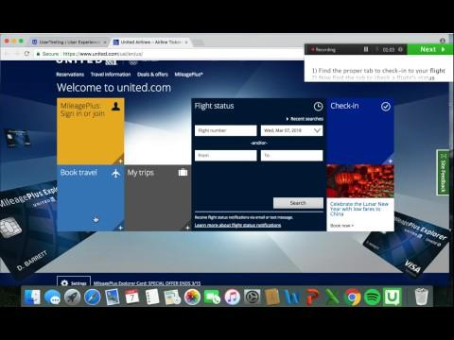
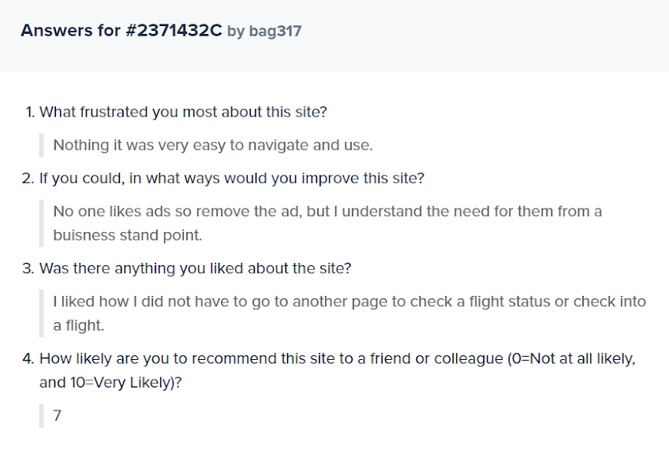
Tester 3: No Issues
Notes:
The third tester didn’t have any problems either, but did end up navigating to a separate page for the third task instead of just using the designated tab. This user mentions in the end of her testing that it would make more sense to have the hotel reservations grouped in with the rest of the tabs. Since it already is grouped under “Book Travel”, it shows that that titling is not obvious enough for a user to go there for hotel reservations and such. Yet again, this user gave a wholly positive review for site except for her mention of the placement for reservations.

Slide 13
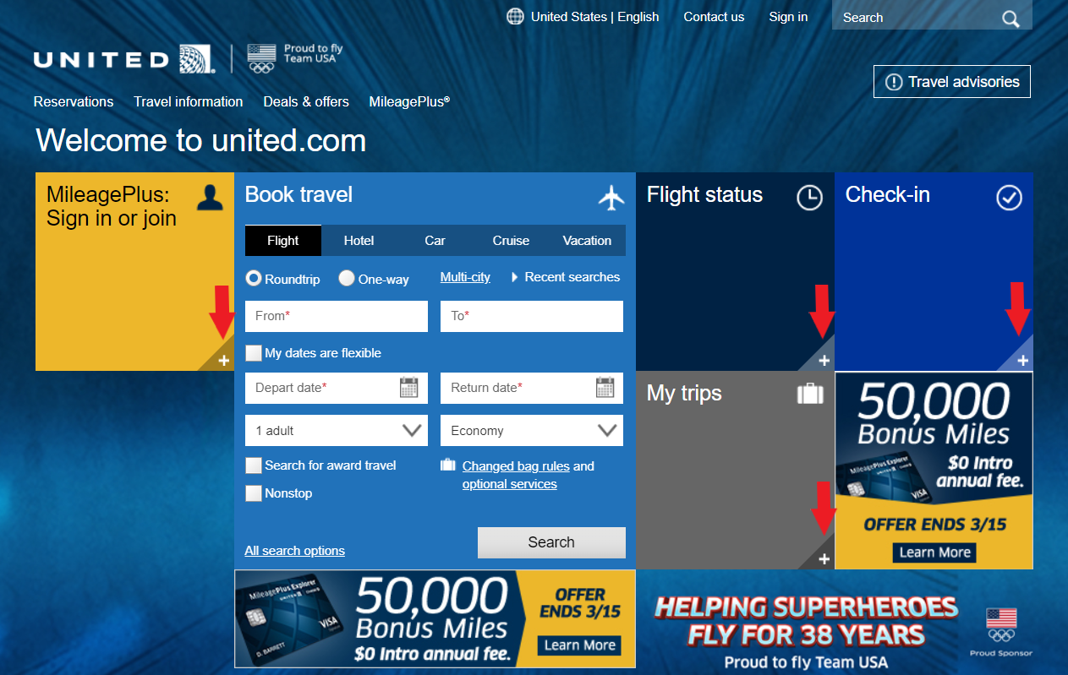

Issue 1: Discoverability (Change Signifier)
Notes:
After spending some time with the site, you may or may not notice that each of the expandable boxes actually has a small plus in the corner to show the user that they can interact with it. We felt that it was too easy to miss, and thus didn’t do its job correctly, as some of our group members didn’t even realize the boxes were interactable until we started messing around. When we asked our three testers, most of them didn’t notice them either, but just proceeded to click on the boxes anyways. A way to do this would be plus (+) to a chevron down arrow to give a better indication of how the sections will open. We also can change the boxes so they open in one uniform direction.

Slide 14
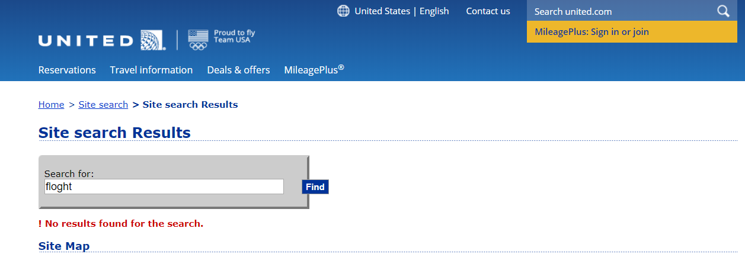
Issue 2: Slips Can Occur on Search
Notes:
The second issue we found with the site has to do with its search bar, and how easily slips can occur with it. If you make a slip and type a misspelled or incorrect word in the search bar, United will give a message on the next page saying “!No results found for the search.” Besides having a slip in itself with the exclamation mark being in front of the sentence, this isn’t a helpful page for users who make a slip. So there are two options, either the results page has results that may be related to what the user was attempting to type through a word guess, or the search itself can be improved. We went with the latter, and feel that when a user is typing into the search box there should be dropdown that guesses what they are typing through frequently searched items, similar to Google, so they can prevent slips by clicking on the dropdown and will get to the page they want faster. Additionally since United doesn’t easily display all that its website has to offer, this can inadvertently prevent any mistakes during searches as well.

Slide 15
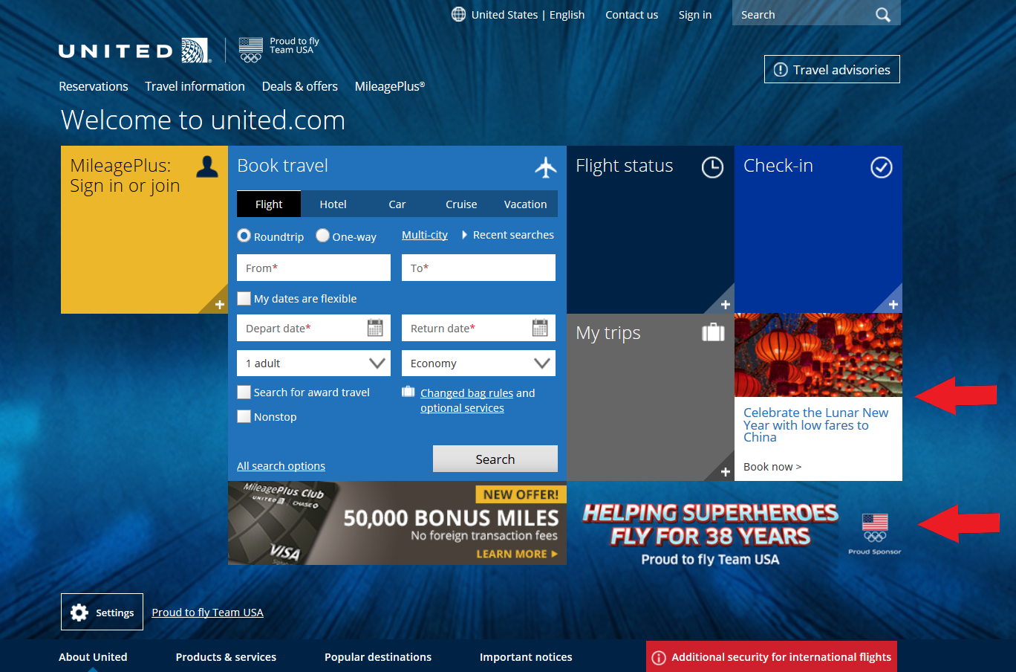
Issue 3: Advertisement Placement
Notes:
The final issue we found with the United site had to do with the placement of advertisements. Yet again, this is not necessarily a deal-breaker, but definitely something that doesn’t help the site or make it easier to use. For starters, one advertisement is placed directly in line with the other expandable “tabs”. As such users may click on it expecting something similar to the other tabs, yet it takes you to a completely different page that at first can be confusing as to what just happened. Additionally, the background advertisement can be quite distracting for users, and changes everytime you go to the website. This has also resulted in United including a settings button in the bottom left hand corner that has the sole purpose of changing in the background image. Instead we suggest the background image should be a slideshow so the advertisements are still there but less distracting from the main content. This follows the idea of the gulf of evaluation and gulf of execution. It took us a while to figure out that’s what the settings button did and reach the gulf of evaluation.

Slide 16
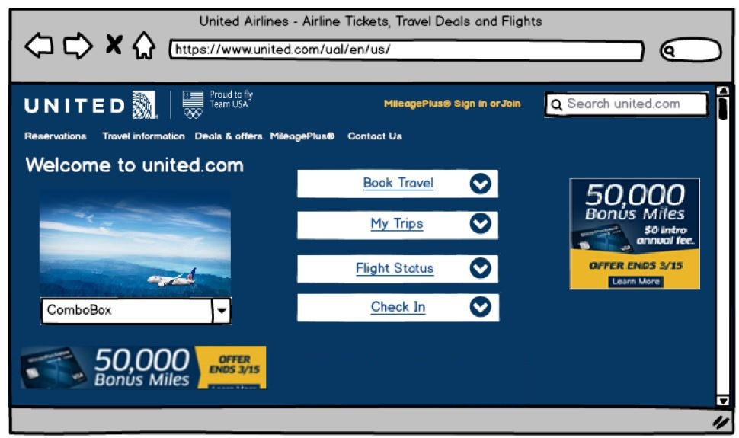
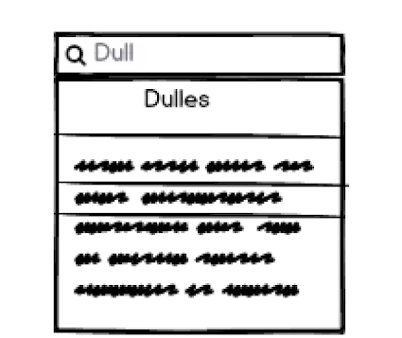

Notes:
In the original United site, it was not clear that the boxes would expand into the sections even though there was a plus signifier at the bottom. By making the “boxes” into rectangles and by making them smaller, it catches your eye making it much easier to know that they can be opened. We decided that it was best if all the boxes opened in one direction.
The advertisements in the background were distracting and there was a settings button to just change the background image. Instead we decided to change it to an automatic slideshow of images where you can choose an image if you wish. Moving the images to a slideshow still allows the pictures/advertisements to still be there but would decrease clutter for the user and bring attention to what is truly important. Also in changing the design of the boxes we moved the boxed advertisements so they would not move with the sections.
The final change we decided on was creating a dropdown on search. This will reduce the slips that could occur. For example if you start writing the word Dulles but misspell it, it will go to the next page and say "no results found for the search". Instead if we can catch the users slip before they can make it we can make users happier.

Slide 17


Reasoning
Small Pluses/Indicators = Bad Discoverability
Moving/Expanding Boxes = Unnecessary & Confusing
Moving & Large Advertisements = Distracting
Bad Naming Conventions = Causes Users to Navigate Away from Site
Notes:
Micro interactions are a big part of the whole user experience process these days. However, for micro interactions to be effective, they should be easy to use and clearly visible to the users. Hence the small plus to make the boxes bigger is a good idea as a micro interaction but they need to be bigger ( so they’re more visible to the users) to make them as effective.
Once the website is loaded, the boxes are aligned next to each other but once you click on the plus icon the layout of the whole website changes as the boxes change their positions which disturbs the users’ current mental model and causes more errors/mistakes.
Content is the main part of any website online. But when advertisements come in the way of your content, it gets very annoying and even the most interesting content starts to annoy when you have to keep scrolling through the ads in between the main content. Hence we decided to change the size and the position of the ads on our design.
As I said in my last point, content is the most important part of the website. And if the content (like the naming conventions) are not appropriate/relevant, the user would not want to use your website even if its design is very cool. Hence the sitemaps and the naming conventions should be well organized and relevant to your website’s content.

Slide 18


Lessons Learned from User Testing
More specific about staying on main page to complete tasks
Have less steps in one task
Notes:
I’ve learned over time how to get more effective feedback through this assignment. Humans are very predictable in our unpredictability. If you watch for certain patterns, you can increase your ability to discover insights that would normally be hidden. Two of the major things I learned from usability testing are:
Users are keen on staying on the homepage to complete most of their tasks. Hence a good interface designer should have most of the important things available on the homepage to make it more usable for the users.
Taking multiple steps for a single task can be frustrating for the user. A designer must use the usability principles like signifiers, recognition over recall, etc. to make a user’s experience much easier, simplified and less time consuming

